Slide 1

Introduction to Sorting Algorithms
Sorting algorithms are fundamental building blocks in computer science. They provide systematic methods for arranging a collection of items, such as numbers, characters, or objects, in a specific order. Understanding sorting algorithms is crucial for efficient data management, search operations, and a wide range of applications in fields such as databases, machine learning, and operating systems.
by Esha Dey
ED

Slide 2


Slide 3

Overview of Quick Sort
Quick sort is a highly efficient sorting algorithm that follows a divide-and-conquer approach. It works by selecting a pivot element within the array and partitioning the remaining elements into two sub-arrays: one containing elements smaller than the pivot and another containing elements greater than the pivot. This partitioning process is repeated recursively on the sub-arrays until the entire array is sorted. The key to Quick Sort's performance lies in the efficient partitioning process, which divides the problem into smaller subproblems that can be solved independently.
1
Strengths
2
Weaknesses
Quick sort is known for its average-case time complexity of O(n log n), which makes it highly efficient for large datasets. It is also an in-place sorting algorithm, meaning it sorts the elements within the original array without requiring additional memory.
Quick sort has a worst-case time complexity of O(n^2) if the pivot selection is consistently poor, leading to unbalanced partitions. This can occur when the input array is already sorted or nearly sorted. In such cases, other sorting algorithms may perform better.
Esha Dey

Slide 4



Implementation of Quick Sort
The implementation of Quick sort involves defining a partitioning function and a recursive sorting function. The partitioning function selects a pivot element, arranges the elements around it, and returns the index of the pivot. The recursive sorting function then applies partitioning to the sub-arrays, recursively calling itself until the entire array is sorted. The choice of pivot element significantly affects the algorithm's performance. Common pivot selection strategies include choosing the first element, the last element, or a random element from the array.
Partitioning
Recursive Sorting
The partitioning function involves selecting a pivot element and rearranging the elements in the array such that all elements smaller than the pivot are placed before it, and all elements larger than the pivot are placed after it. The pivot's final position is returned.
The recursive sorting function applies partitioning to the sub-arrays created during the previous step. It recursively calls itself on these sub-arrays until the entire array is sorted.
Esha Dey

Slide 5
Overview of Merge Sort
Merge Sort is another efficient sorting algorithm that employs a divide-and-conquer approach. It divides the input array into smaller sub-arrays, sorts them recursively, and then merges them back together to create a fully sorted array. Merge sort's strength lies in its stability, meaning that it preserves the relative order of equal elements in the input array. This property makes it suitable for sorting data with multiple keys or complex data structures.
Divide
Conquer
Combine
The input array is repeatedly divided into two halves until it is reduced to individual elements, which are considered sorted by default.
The sub-arrays are recursively sorted using the merge sort algorithm, ensuring that each sub-array is in sorted order.
The sorted sub-arrays are merged back together in a pairwise manner, comparing elements from each sub-array and placing the smaller element into the merged array. This process continues until all sub-arrays are merged into a single sorted array.
Esha Dey

Slide 6

Implementation of Merge Sort
Implementing Merge Sort involves defining a merge function and a recursive sorting function. The merge function takes two sorted sub-arrays as input and merges them into a single sorted array. It compares elements from each sub-array and places the smaller element into the merged array. The recursive sorting function divides the input array into two halves, recursively calls itself to sort the halves, and then merges the sorted halves using the merge function. This process is repeated until the entire array is sorted. The efficiency of Merge Sort lies in its ability to merge sorted sub-arrays in O(n) time, resulting in an overall time complexity of O(n log n).
Step 1
Divide the unsorted array into n sub-arrays, each containing 1 element.
Step 2
Repeatedly merge sub-arrays to produce new sorted sub-arrays until there is only 1 sub-array remaining. This will be the sorted array.

Slide 7
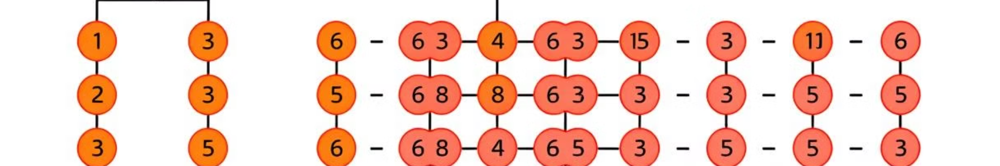



Overview of Heap Sort
Heap Sort is an in-place sorting algorithm that leverages a binary heap data structure. A binary heap is a complete binary tree that satisfies the heap property: the parent node is always greater than or equal to its children (for a max-heap) or less than or equal to its children (for a min-heap). Heap sort builds a max-heap from the input array and repeatedly extracts the maximum element from the heap, placing it at the end of the array. This process is repeated until the heap is empty, resulting in a sorted array.
Heap Data Structure
Heapify
Sorting
Heap sort utilizes a binary heap, a complete binary tree that satisfies the heap property. This property ensures that the largest element is always at the root of the heap.
The heapify operation is used to maintain the heap property after an element is inserted or removed. This involves rearranging the nodes to ensure that the heap property is preserved.
The sorting process involves repeatedly extracting the maximum element from the heap and placing it at the end of the array. This is repeated until the heap is empty, resulting in a sorted array.
Esha Dey

Slide 8
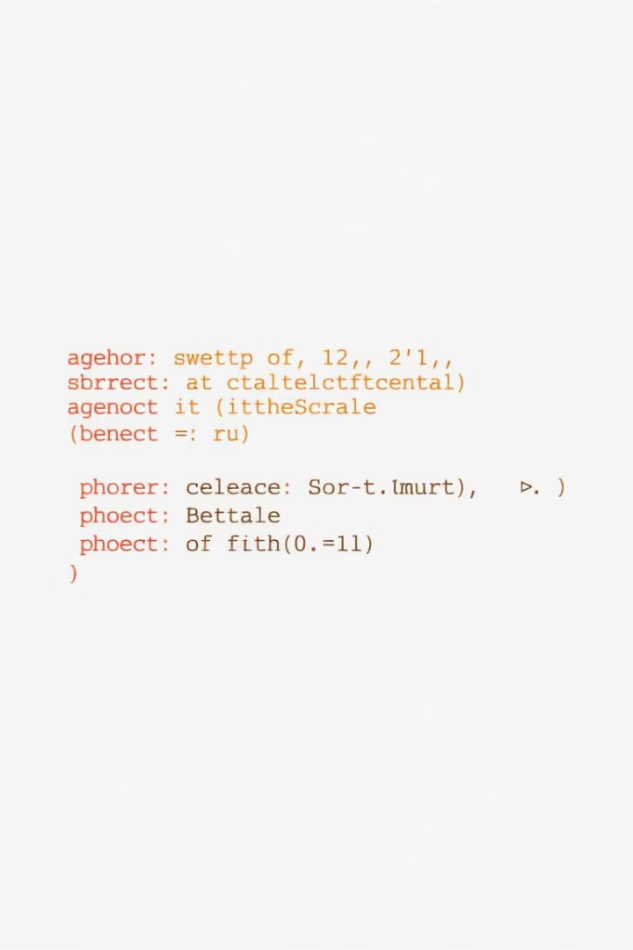
Implementation of Heap Sort
The implementation of Heap Sort involves two key steps: building a max-heap from the input array and repeatedly extracting the maximum element from the heap and placing it at the end of the array. The process of building a heap involves iterating through the array from the middle element to the first element, performing the heapify operation at each element. The heapify operation maintains the heap property by swapping the element with its larger child if necessary, recursively applying this process to the child node. Once the heap is built, the maximum element is at the root of the heap. It is then swapped with the last element in the array, effectively placing it at the end of the sorted portion. The heap is then reduced in size by one, and the heapify operation is performed at the root node to maintain the heap property.
1
Build Heap
The first step in Heap Sort is to build a max-heap from the input array. This involves iterating through the array from the middle element to the first element, performing the heapify operation at each element.
2
Extract Max
After the heap is built, the maximum element is at the root of the heap. It is then swapped with the last element in the array, effectively placing it at the end of the sorted portion.
3
Heapify
The heap is then reduced in size by one, and the heapify operation is performed at the root node to maintain the heap property. This process is repeated until the heap is empty, resulting in a sorted array.
Esha Dey

Slide 9
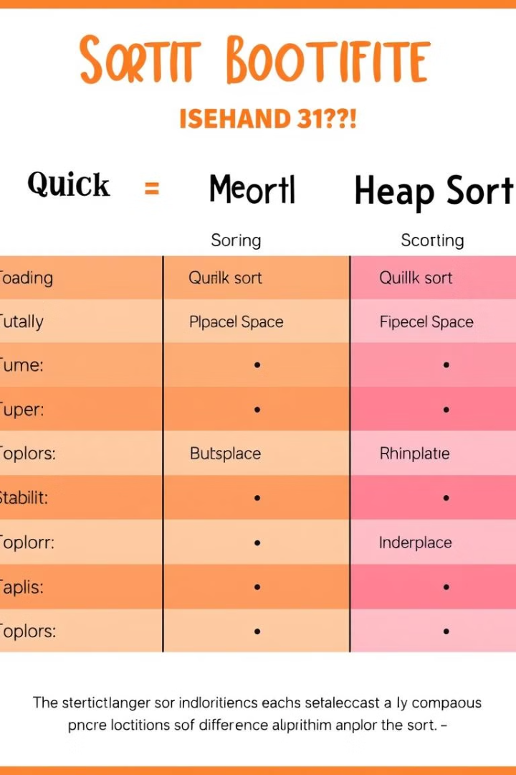
Comparison and Analysis of the Sorting Algorithms
When comparing and analyzing the sorting algorithms, we consider key factors such as time complexity, space complexity, stability, and in-place sorting. Quick Sort boasts an average-case time complexity of O(n log n) and is an in-place sorting algorithm, making it efficient for large datasets. However, its worst-case time complexity of O(n^2) can be problematic in certain scenarios. Merge Sort guarantees a time complexity of O(n log n) and is stable, preserving the relative order of equal elements. It requires additional memory for merging, but its stable nature makes it suitable for sorting complex data structures. Heap Sort is an in-place sorting algorithm with a time complexity of O(n log n), but it is not stable. Each algorithm has its own strengths and weaknesses, and the best choice depends on the specific requirements of the application.
Algorithm
Time Complexity (Average Case)
Time Complexity (Worst Case)
Space Complexity
Stable
In-Place
Quick Sort
O(n log n)
O(n^2)
O(1)
No
Yes
Merge Sort
O(n log n)
O(n log n)
O(n)
Yes
No
Heap Sort
O(n log n)
O(n log n)
O(1)
No
Yes
Esha Dey

Slide 10
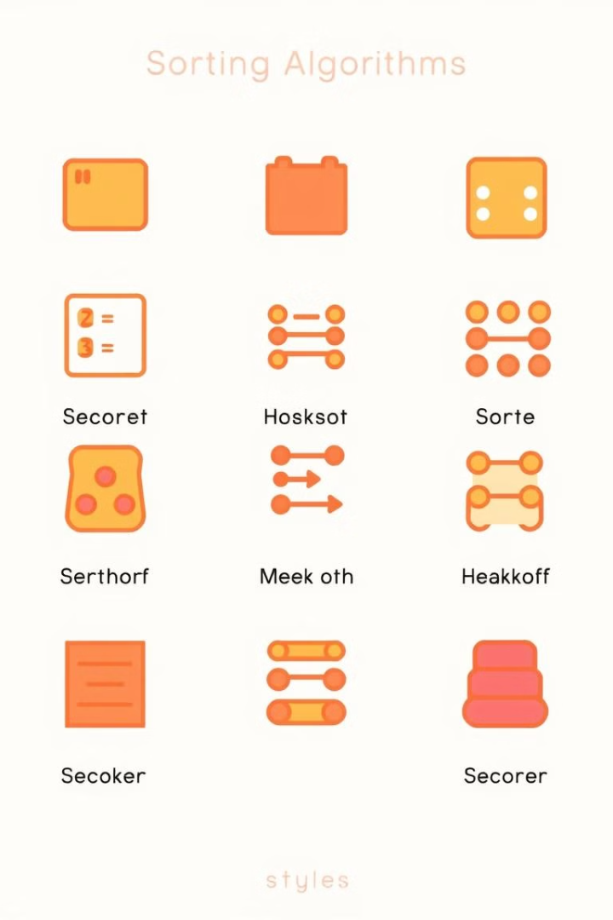
Conclusion
Sorting algorithms play a vital role in computer science, providing efficient methods for arranging data in a specific order. Quick Sort, Merge Sort, and Heap Sort are three commonly used algorithms, each with its own strengths and weaknesses. Quick Sort excels in average-case performance and is an in-place algorithm. Merge Sort guarantees a consistent time complexity and is stable, while Heap Sort is an in-place algorithm with a time complexity of O(n log n). The choice of sorting algorithm depends on the specific requirements of the application, such as data size, stability, and memory constraints. Understanding these algorithms and their characteristics is essential for making informed decisions and achieving optimal performance in data processing and management tasks.

